Slide 1
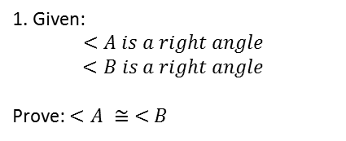
Name:_______________
Beginning Proofs - Intervention
A
D
1. Given:
$$<A is a right angle$$
$<B is a right angle$
Prove: $<A ≅ <B$
B
C
Statements
$<A is a right angle$
__________________
$<A ≅ <B$
Reasons
__________________
$Given$
__________________
2. Given:
$$Diagram as shown$$
Prove: $<ABC ≅ <XBZ$
A
B
Z
X
C
Statements
1. _____________________
2. _____________________
3. _____________________
4. _____________________
Reasons
Given
Assumed from Diagram
Assumed from Diagram
If 2 angles are straight angles, then they are congruent

Slide 2
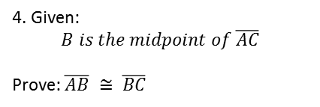
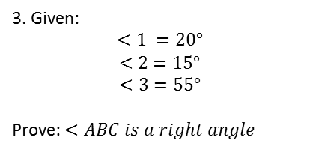
3. Given:
$$<1 =20°$$
$<2=15°$
$$<3=55°$$
Prove: $<ABC is a right angle$
B
1
3
2
A
C
Statements
1. _____________
2. _____________
3. _____________
4. _____________
5. _____________
Reasons
_______________
_______________
_______________
_______________
_______________
A
4. Given:
$$B is the midpoint of \overline{AC}$$
Prove: $\overline{AB} ≅ \overline{BC}$
B
D
C
Statements
Reasons

