Slide 1
What happens when you ASSUME?

Slide 2
A canyon in the middle of the street?!
“Duality” 3-d chalk drawing by Edgar Muller in Moscow, Russia

Slide 3
A mummy is coming to get you?!
Tracy Lee Stum 3-d street painting

Slide 4
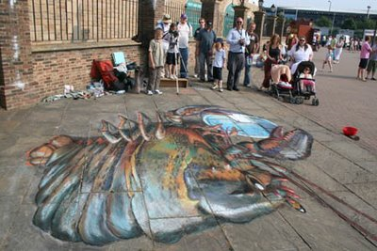
A baby being eaten by a giant lobster?!
Julian Beever 3-d chalk drawing

Slide 5
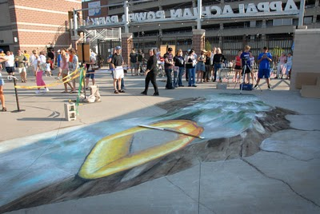
River rafting down the street?!
Julian Beever 3-d chalk drawing

Slide 6
A dangerous crossing?!
Lion’s Gate Gorge 3-d chalk drawing by Qi Xinghua

Slide 7
A giant hole in the city’s main square?!
3-d illusion in Sergels Torg Square,
Sweden by Erik Johansson
http://alltelleringet.com/generation7/

Slide 8
A grassy orb in the middle of the sidewalk?!
Created in Paris by Francois Abenalet: sidewalk installation using chalk drawings and actual grass and trees. Example of anamorphosis -- a distorted image that only takes its "proper" form when viewed from exactly the right angle.

Slide 9
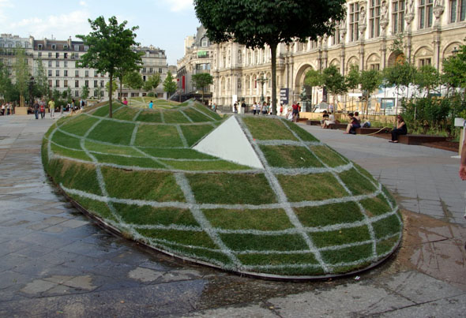

Slide 10
Red ribbons hanging across the streets?!

Slide 11
Nope, just red lines painted on buildings!
Place de l’Odeon, Paris

Slide 12
A man with a fish for a head?!

Slide 13
What in the world?!

Slide 14
Mini-soldiers?!

Slide 15
President Obama and Vice President Biden are Siamese twins?!

Slide 16
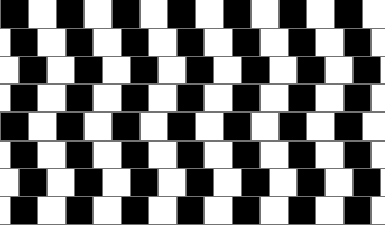
Some more common illusions…
Which center circle is bigger?
Are the horizontal lines parallel?
Are the vertical and horizontal lines perpendicular?
http://www.sapdesignguild.org/resources/optical_illusions/geometrical.html
http://www.ophtasurf.com/en/illusionpage5.htm
Which horizontal line is shorter?

Slide 17
Assumptions from diagrams
You SHOULD assume
You SHOULD NOT assume
Straight lines and angles
Collinearity of points
Betweenness of points
Relative positions of points
Right angles
Congruent segments
Congruent angles
Relative sizes of segments and angles
We CAN say…
C is between B and D, A and E
Angle DEF is a straight angle
B, C, and D are collinear
A, C, and E are collinear
D, E, and F are collinear
F is to the right of C, etc.
ACE, DEF and BCD are straight lines
A
B
We CANNOT say…
Angles ADE, FBD are right angles
AE is congruent to BF
BC is longer than CD
Angle AED is congruent to angle BFD
Angle ACB is an obtuse angle
C
D
F
E

Slide 18
How can we prove that ∠ADE is a right angle?
B
Measure it
Use ∠ADC and ∠CDE
A
C
58°
32°
D
F
E
m∠ADC = 58° and m∠CDE = 32°
∠ADE = ∠ADC + ∠CDE
∠ADE = 58° + 32° = 90 °
Therefore, ∠ADE is a right angle by the definition of a right angle

Slide 19
Can we prove that ∠ADE and ∠FBD are congruent?
A
B
The box in the corner of ∠FBD means it is a…
RIGHT ANGLE!
C
58°
32°
D
F
E
By definition, the measure of a right angle is 90°
Previously, we established that ∠ADE was also a right angle
This means that the measure of ∠ADE is also 90°
Therefore, ∠ADE and ∠FBD have the same measure and are, by definition, CONGRUENT!

Slide 20
Two Theorems
A theorem is a mathematical statement that can be proven
If two angles are right angles, then they are congruent.
short: All rt ∠s are ≅
If two angles are straight angles, then they are congruent.
short: All straight ∠s are ≅

Slide 21
Homework and Exit Slip
Homework: Complete the worksheet
Exit Slip
Name one thing you CAN assume from a diagram
Name one thing you CAN’T assume from a diagram.

